Slide 1

SOA Framework
10-24-06

Slide 2

Agenda
SOA Introduction
SOA Benefits
SOA Principles
SOA Framework
Governance
Measurement
Tools
Strategic (long term) View…

Slide 3
Introduction to SOA
Service-oriented architecture (SOA) is an approach to loosely coupled, protocol independent, standards-based distributed computing where software resources available on the network are considered as Services.
SOA is believed to become the future enterprise technology solution that promises the agility and flexibility the business users have been looking for by leveraging the integration process through composition of the services spanning multiple enterprises

Slide 4
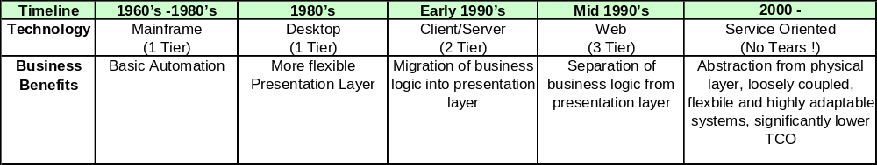
Introduction to SOA
Evolution of business automation …
SOA provides the flexibility to rapidly adapt systems
to meet changing business needs in a cost effective way.

Slide 5
Introduction to SOA
Graphic from Booz|Allen|Hamilton
Lightweight Application
Integrated
Tightly Coupled
Lengthy, High Risk, Costly Development
Costly Maintenance
Visualization
New
Business Logic
Application Service
Flexible
Loosely Coupled
Agile Development
  rapid,
  lower cost,
  lower risk
Lower support costs
Application Service
Utilities
Core Enterprise Services
Messaging
Storage
Re-used
Storage Service
Utility Services
Security Services
Security
Messaging Services
Platform Centric
Net-Centric
Migration from “brittle-ware” to software

Slide 6
Introduction to SOA
Key Characteristics of Services
  The software components in a SOA are services based on standard protocols.
  Services in SOA have minimum amount of inter-dependencies.
  Communication infrastructure used within an SOA should be designed to be independent of the underlying protocol layer.
  Offers coarse-grained business services, as opposed to fine-grained software-oriented function calls.
  Uses service granularity to provide effective composition, encapsulation and management of services.

Slide 7
Introduction to SOA
Key Definition:
  Service granularity refers to the scope of functionality a service exposes. Fine-grained services provide a small amount of business-process usefulness, such as basic data access. Coarse-grained services are constructed from fine-grained services that are intelligently structured to meet specific business needs.

Slide 8
Benefits of SOA
Provides location independence: Services need not be associated with a particular system on a particular network
Protocol-independent communication framework renders code reusability
Offers better adaptability and faster response rate to changing business requirements
Allows easier application development, run-time deployment and better service management Loosely coupled system architecture allows easy integration by composition of applications, processes, or more complex services from other less complex services
Provides authentication and authorization of Service consumers, and all security functionality via Services interfaces rather than tightly-coupled mechanisms
Allows service consumers (ex. Web Services) to find and connect to available Services dynamically

Slide 9
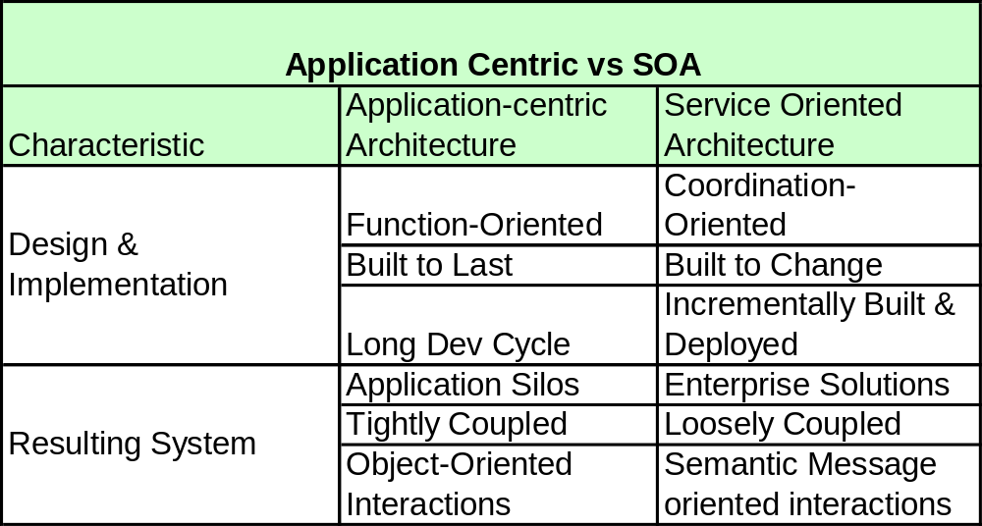
Benefits of SOA

Slide 10
SOA Principles
Ensure that services are aligned to business processes and models (data models, ontologies and taxonomies).
All services should be published into a central directory (common registry = UDDI)
Services should be abstracted from the physical layer, specific tools, products and languages.
Service should meet their commitments and demonstrate compliance through instrumentation & reportable metrics.

Slide 11
SOA Principles
Services should be adaptable, independent, flexible, efficient and resilient.
Services should be self contained and modular.
Services should be loosely coupled.
Ensure services are reusable by mapping discrete business processes to services and establishing sets of commonly available services within each layer.

Slide 12
SOA Framework (Generic Taxonomy)
Enterprise Business Processes
Enterprise & Business Services
Data
Integration
Services
Strategic
Road Mapping
Business
Planning
Business
Modeling
Business Perf.
Mgmt Services
Business
Collaboration
Domain Services
PLM
Services
Collaboration
Services
BI
Services
Process Mgmt
Services
Capacity
Mgmt Services
Utility Services
Workflow
Services
Security Mgmt
Services
Portfolio Mgmt
Services
Demand & Resource
Mgmt Services
Data Mgmt
Services
Foundation Services
Application
Integration
Services
Orchestration / BPM
Monitoring / BAM
Personalization
Scheduling
Business Rules
ODS
Authorization
Authentication
Auditing
Transformer
Transformation
Configuration
Logging
Transaction
Adapter
Data Access

Slide 13
SOA Framework (Taxonomy Definitions)
Enterprise Business Processes
  These are typically defined, diagramed (eventually, modeled in a BPM tool) and make use of the underlying services mentioned below.
Enterprise / Business Services
  Business Services (LOB) – (Order Mgmt, Inventory Mgmt, HR, Finance)
  Enterprise Services – Commonly used across all LOBs (approve, escalate, validate)
  Domain Services – These are specific to a LOB (Benefits Update, Customer Search, Budget Inquiry, Order Add, Order Update)
  Utility Services - (address lookup, mail, print, document mgmt)
Foundation Services
  These are commonly used “fine-grained” services which access the Technology Architecture (security, logging, auditing, orchestration). These are woven together by higher level services.
Application Integration Services
  Provides abstraction to the applications. Application functionality is exposed using these services to provide simplicity & insulation.
Data Integration Services
  Provides abstraction to the data sources

Slide 14
Governance
Scope includes:
  Prioritizing which services are built
  Validating compliance with architecture principles
  Encouraging reuse
  Change Management (see lifecycle mgmt)
  Control provisioning of services
  Monitoring Services
  Ensuring compliance to business SLA

Slide 15
Governance
Lifecycle Management for Services:
  Develop & Enable Service:
    Specify the properties, policies & function points
    Place the service into one of the 3 SOA layers
  Publish Service:
    Provider creates a WSDL document
    Provider publishes the WSDL on a Web Server
    Provider inserts an URL into the WS registry using (UDDI).
  Discover Service:
    Search the registry.
    Retrieve the URL
    Download the WSDL file.
  Manage Service:
    Monitoring & Maintenance (includes dependencies, policies, security and related run-time issues).

Slide 16
Governance
Roles & Responsibilities:
  We start with 3 basic “players” to create a service:
    The service provider (publish)
    The service requestor (find)
    The service registry (bind)
  We add additional players to provide governance and control to manage the assets and ensure the business commitments are met:
    Architecture
    Change Control Board (CCB)
    Business Process Owners
    SQA

Slide 17
Governance
SAP NetWeaver Administrator Responsibilities
  Start & Stop
  Change configuration
  Transport software changes
  Backup & Recovery
  Output Management
  User Management
  Job Scheduling
  Monitor systems
  Incident analysis

Slide 18
Governance
Change Management (must address 5 key viewpoints):
  Developer’s View (implementation & testing)
  Designer’s View (design, function pts & logic required for service)
  Quality Control View (traceability from use cases throughout development lifecycle, migration from Dev-Test-Prod)
  Architectural View (adherence to standards & principles)
  Business View (use cases / requirements, business process automation)
  see next slide…

Slide 19
Governance:
Designer
(Logical )
View
Developer
(Build & Implement)
View
Business
(Use Case)
View
Architecture
(Principles)
View
Quality Control
(Deployment)
View
The 5 Viewpoints of SOA

Slide 20
Measurement
Key metrics that we will want to consider capturing:
Architecture
  Reusability
  Availability
  Resiliency
  Adaptability
Governance
  Traceability between Business Processes & Services
  Adherence to standards
  Change Mgmt / QE Metrics
Operational
  Performance
  Usage
  Reliability

Slide 21
Tools
SAP – System Landscape Directory
SAP – Solution Manager
SAP – Netweaver / XI
UDDI Registry – IBM’s Tool (recommendation)
Java – Web Service using SOAP Protocol
3rd Party – Connectors
Enterprise Modeling Tool *
*Reference the Data Management Framework RFI

Slide 22
Glossary of Terms
SOA Terms | Examples
UDDI | Phone Book
WSDL | Contract
SOAP | Envelope
HTTP, SMTP, FTP | Mailperson
Programming (DOM, SAX) | Speech
Schema (DTD, XSD) | Vocabulary
XML | Alphabet

Slide 23
Sample Design Docs for
Service (XI_Export_Products)

Slide 24
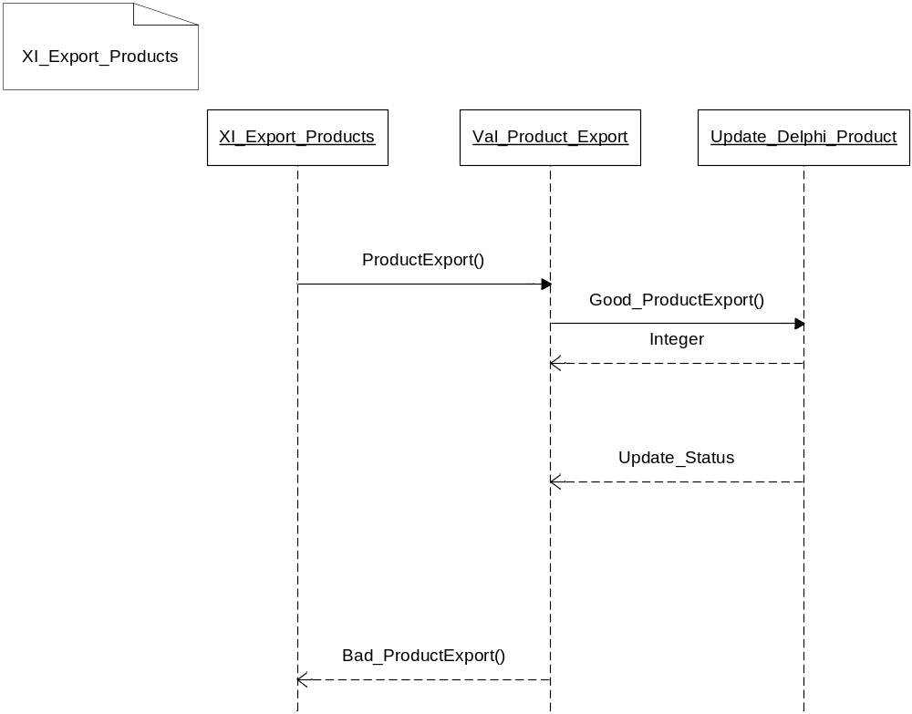
Sample: Sequence Diagram

Slide 25
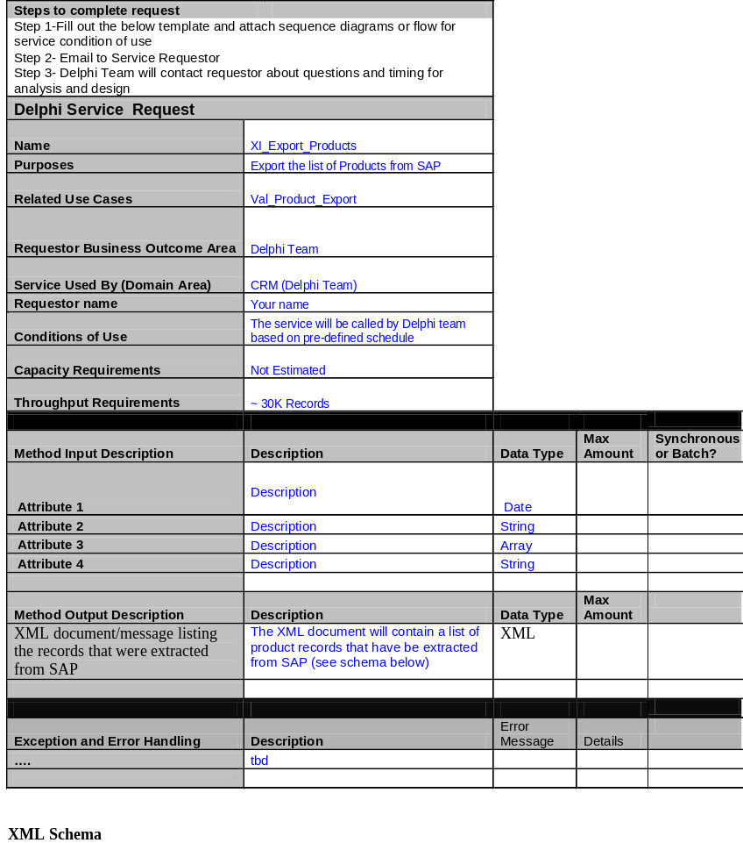
Sample: WSDL
Double-click to see the entire document.

Slide 26
Strategic (long term) View…

Slide 27
SOA Framework
Eventually, we will leverage Metadata to provide abstraction and adaptability for services:
  Bindings (to the data and/or physical layer)
  Business rules (logic, validation, diagnostics, error mgmt, escalation, event management)
  Ontologies for Services (will drive naming conventions)
  Eventually, semantic models will be introduced to manage Ontologies and meta models across domains (both inter and extra company)

Slide 28
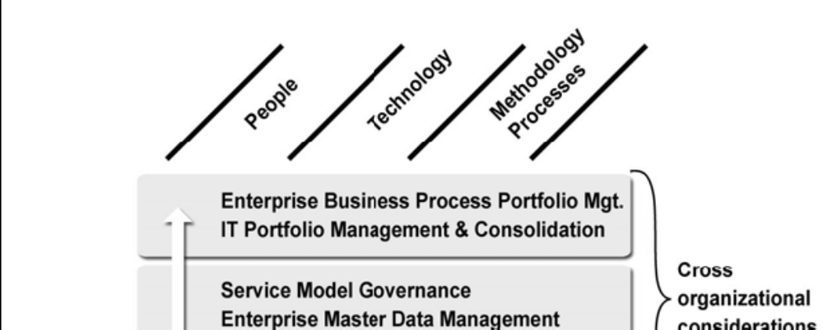
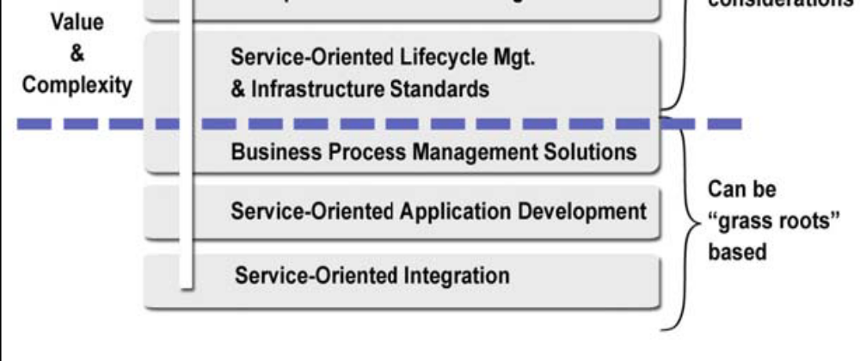
Introduction to SOA
©2006 MomentumSI
SOA Adoption Guide
While grassroots efforts can also produce positive ROI, the value threshold is crossed when decisions start being made that impact multiple projects or organizational units.
At that point you are making shared infrastructure investments, developing models to share services and master data across the enterprise, and taking a conscious approach to managing the IT Portfolio around business process contributions and value.

Slide 29
SOA Framework
Some Common Patterns:
  Transforms
    Data Cleansing
    Data Mapping
  Transaction
    Referential Integrity
    Serialization
    Parallel Processing
    State Management
  Validation
    Pattern Matching
    Type checks
    Format checks
    Boundary checks
    Reasonableness checks

Slide 30
Governance
Future SOA Model (1 of 2)
Domain / View | Requirements | Specifications | Implementations
 | (Conceptual) | (Logical) | (Physical)
Business | Standardized business services | Business Service Bus | WSDL specifications
 | Business virtualization | BPO Service architecture | UDDI based service registry
 | Purely information based products | Information service specifications | WSDL specifications
 | Service based product components providing value add to physical products | Service product specifications | WSDL specifications
Information | Definition of the real information owner, internal and external to the business and strategy for managing that class of information | Information currency and ownership distribution analysis | Information access services
 | Common semantics and domain applicability (business unit, enterprise, ecosystem, sector etc) | Semantic standards | XML documents and mapping and transformation rules
Application |  | Applications redefined as sets of business objects and related services | Applications acquired as (hosted) services
Service | Service is first order construct in business process | Service as unit of provision and consumption | Delivered service
 | Standard/common business services | Standard/common business services | Standard/common business services
 |  | Standard/common infrastructural services | Standard/common infrastructural services
 | Business service patterns | Domain business service patterns
 | Business service contract templates | Service specification contract templates and reusable components | BPEL4WS or ebXML template specifications

Slide 31
Governance
Future SOA Model (2 of 2)
Domain / View | Requirements | Specifications | Implementations
 | (Conceptual) | (Logical) | (Physical)
Component | Business domains mirror business requirements for articulation | Business components encapsulate a single business concept (entity or process) | Offers well defined network interfaces that offer services
Middleware | Business Service Bus | Wire protocol standards | XML Messages
 |  | Message security services | Message security services
 |  |  | Component and Service container
Service Management | Business rules | Rule specifications | XSLT or similar
 | Business policies | Policy specifications | XSLT or similar
 | Business service requirements | Service Level Agreements | Dependency specifications, thresholds, contingency plans
 | Business trust requirement | Trust specification | Monitoring policies and rules, breakpoints and escalation specifications
 |  | Management services pipeline | Management services pipeline
Platform |  | Grid based services virtualize physical platform resource | Platform functionality delivered as services
 |  | Integrity Units define domains for trust, resource management, technical | Virtual physical resources
 |  | upgrade
Device | Device independent UI | Service interface specification NOT the User Interface | Service interface specification NOT the User Interface
User | Roles | User profiles | Directory Server

Slide 32
Thank You

